Slide 1
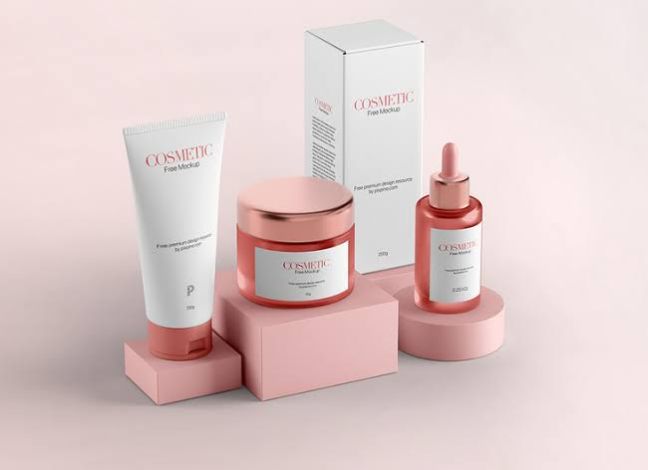
Cosmetic Product Similarity Analysis Using Ingredient Data
Rakesh Reddy Gopireddy

Slide 2
Problem Statement
Difficult Product Comparison
Large Number of Products
Complex Ingredient Lists
Solution:
Ingredient-Based Recommendation System

Slide 3
Project Workflow
Dataset
Data Cleaning
Ingredient Processing
TF-IDF
Cosine similarity
Recommendations

Slide 4
Dataset Overview
Column | Description
Brand | Brand Name
Name | Product name
Price | Product Price
Ingredients | Ingredient List
Skin Type | Dry/Oily

Slide 5
Data Preprocessing
Load Dataset
Filter Moisturizers
Filter Dry skin
Rest Index

Slide 6
Recommendation Engine Methodology
Ingredinet Data
Tokenization
TF-IDF Vectorization
Cosine Similarity
Recommendation Engine

Slide 7
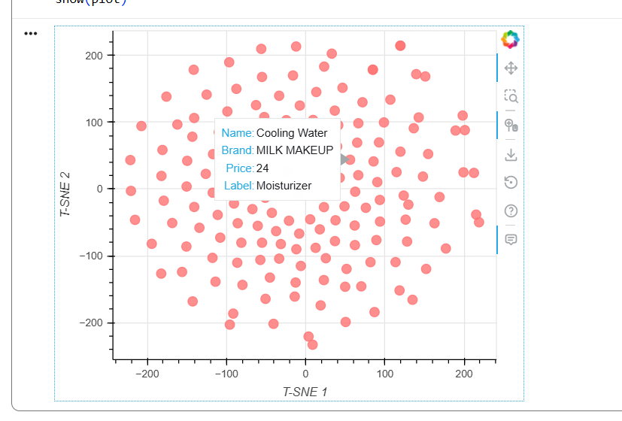
Similar products form clusters
Products with common ingredients stay close together

Slide 8
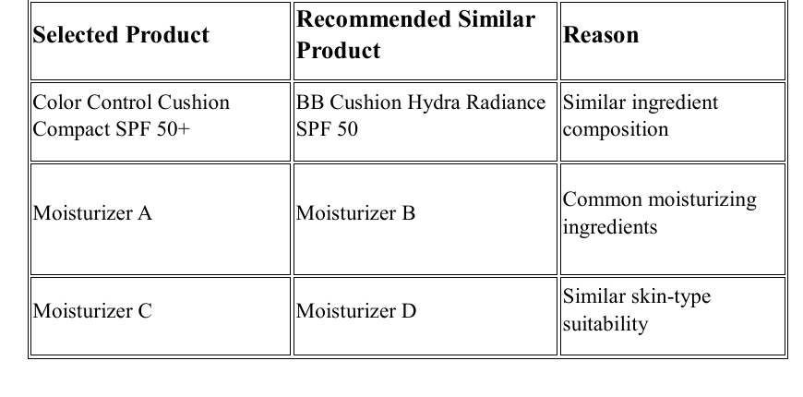
Result
Ingredient Matching
Product Recommendations
Visualization Analysis
Skin-Type Filtering

Slide 9
Conclusion
Developed a recommendation system based on cosmetic ingredient similarity.
Applied TF-IDF, Cosine Similarity, and Visualization techniques to recommend similar skincare products.

